Slide 1
Heart Diseases
Michal Chowaniak
Notes:
My name is Michal Chowaniak, I am going to present analysis about heart diseases.
First I am going to talk about a few facts about heart diseases, than
Literature review, data set, preprocessing, feature selection, scores and models, results and conclusions and recommendations

Slide 2
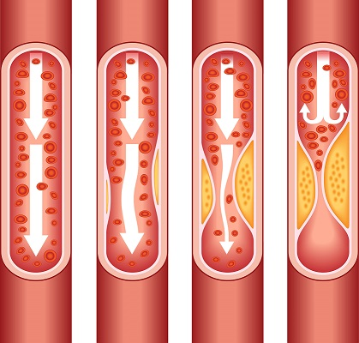
Heart Diseases
Heart disease involve blocked or narrow blood vessels
Heart diseases lead to more serious conditions
Notes:
Why heart disease? It is because it is very important to avoid them.
They all start because fat in a blood narrows blood vessels, which leads to serious consequences over time.

Slide 3
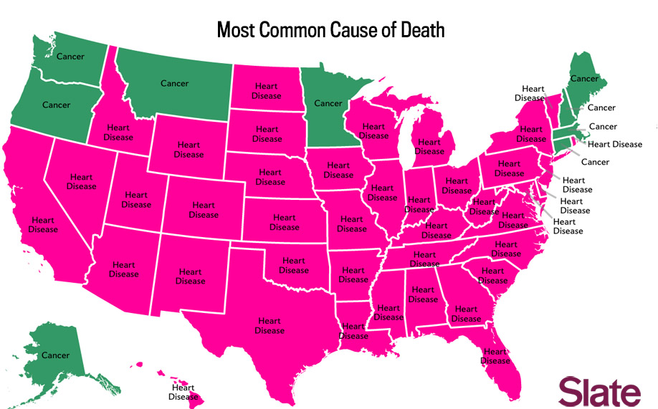
Heart Diseases
Major Problem killing 610,000 people every year in USA
Notes:
Per the Center for Disease Control and Prevention heart diseases kill 610,000.00 people every year.
It is the common cause of death in many states.
There are many factors responsible for heart diseases among them are age, sex, family history, lifestyle, other diseases.

Slide 4
Heart Diseases - Literature Review
Koodali et al (2015) - 95.77% accuracy
Mythili T. et al (2013) - decision tree best model
Abdullah, A. Sheik et al (2012) - 63.22% accuracy
Akin Ozcift et al (2011) - 80.49 accuracy
Resul Das et al (2009) - 89.1% accuracy
Notes:
I ‘ve read several articles about heart diseases and machine learning. The best one was written by Koodali and others published in 2015.
They implemented J48 decision tree, Random Forest, Bagging, Rep Tree, Decision Stump, Cart, Naïve Bayes in Weka and achieved the highest accuracy of 95.77.

Slide 5
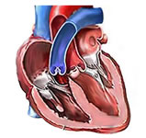
Heart Diseases – Data Set
UCI Machine Learning Repository
Cleveland Heart Disease, 1988
14 variables
303 observations
Some missing values
Notes:
Data set is from UCI Machine Learning repository, it’s called Cleveland Heart Disease, was donated in 1988,
Has 14 variables, 303 observations and a few missing values.

Slide 6
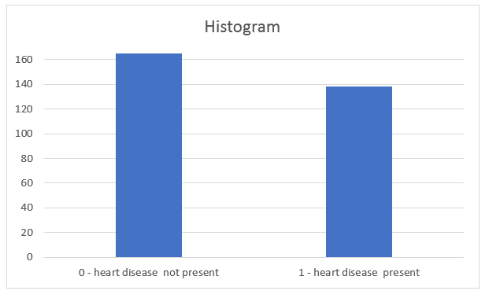
Heart Diseases – Preprocessing
Missing values replaced with mean
Target variable binned to binary
0 - 52%, 1 - 48%
Notes:
Preprocessing step included re-coding missing values to a mean and also binning target variables to 0 no disease and 1 disease present.
After that target variable was balanced 52 to 48

Slide 7
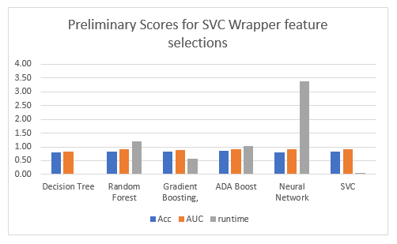
Heart Diseases – Feature Selection
SVC wrapper
Low number of variables
['sex', 'cp', 'fbs', 'exang', 'slope', 'ca', 'thal’]
Decent preliminary scores for each classifier
Notes:
I run over 40 models with different types of features selection methods.
At the end the best one was SVC wrapper, which selected 7 feature with decent preliminary accuracy scores.

Slide 8
Heart Diseases – Feature Selection
Variable name | Description | Chi2
ca | serum cholestoral in mg/dl, level of triglycerides | 84.12
thal | 1 = smoker ; 0 = not smoker | 65.48
exang | exercise induced angina (1 = yes; 0 = no) | 38.05
cp | chest pain type -- Value 1: typical angina; Value 2: atypical angina; Value 3: non-anginal pain; Value 4: asymptomatic | 15.14
slope | the slope of the peak exercise ST segment: 1: upsloping, 2: flat, 3: downsloping | 8.24
sex | 1= male, 0=female | 7.43
fbs | fasting blood sugar > 120 mg/dl) (1 = true; 0 = false) | 0.16
Notes:
The most important features selected by SVC wrapper, using chi-squared scores were:
Level of triglycerides, which is a level of fat in a blood
Smoker/nonsmoker status
Angina which is decreased level of blood flow to heart muscle

Slide 9
Heart Diseases – Confusion Matrix
Predicted/Actual | Fact: You have heart disease | Fact: You do not have heart disease
Your doctor thinks you have heart disease | TP- True Positive Your doctor told you that you have heart disease and you really have it | FP- False Positive Your doctor told you that you have heart disease, but in fact, you do not have it.
Your doctor thinks you do not have heart disease | FN – False Negative Your doctor told you that you do not have heart disease, but you have it | TN – True Negative Your doctor told you that you do not have heart disease, and in fact, you do not have it.
Notes:
The most important measures in this confusion matrix are
TP – true positive , which is used to calculate accuracy
FN - false negative , which is used to calculate recall
The goal is to have build a model with high accuracy and high recall

Slide 10
Heart Diseases – Scores
Important Scores
Accuracy - a measure of how many results were classified correctly, TP, TN,
Recall - a measure of how many truly relevant results are returned, FN
AUC - a measure of classification performance
Notes:
Accuracy - Your doctor told you that you have heart disease and you really have it
And Your doctor told you that you do NOT have heart disease, and in fact, you do NOT have it.
Recall – Your doctor told you that you do not have heart disease, but you have it.
AUC – how much better the model is over 50/50 chance.

Slide 11
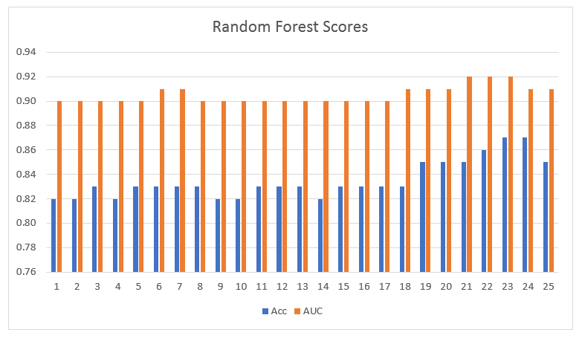
Heart Diseases – Random Forest
Accuracy 0.87
AUC 0.92
Recall 0.83
Notes:
I prepared 25 Random Forest models with various paraments, the best one was #23 with average accuracy of 0.87, auc 0.92 and recall 0.83.
I attempted to improve it by using grid search, but it was not better.

Slide 12
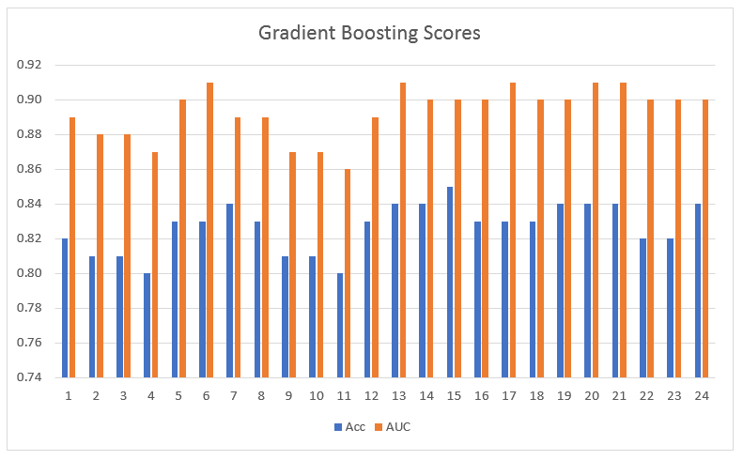
Heart Diseases – Gradient Boosting
Accuracy 0.85
AUC 0.90
Recall 0.80
Notes:
Next I prepared 24 Gradient Boosting models with various paraments, the best one was #15 with average accuracy of 0.85, auc 0.90 and recall 0.80.
I attempted to improve it by using grid search, but it was not better.

Slide 13
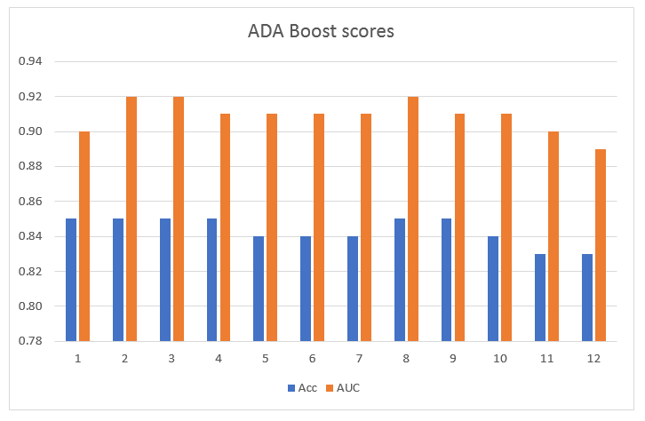
Heart Diseases – Ada Boost
Accuracy 0.85
AUC 0.92
Recall 0.81
Notes:
Next I prepared 12 different Ada Boost models, the best one was #3 with average accuracy of 0.85, auc 0.92 and recall 0.81.
I attempted to improve it by using grid search, but it was worse.

Slide 14
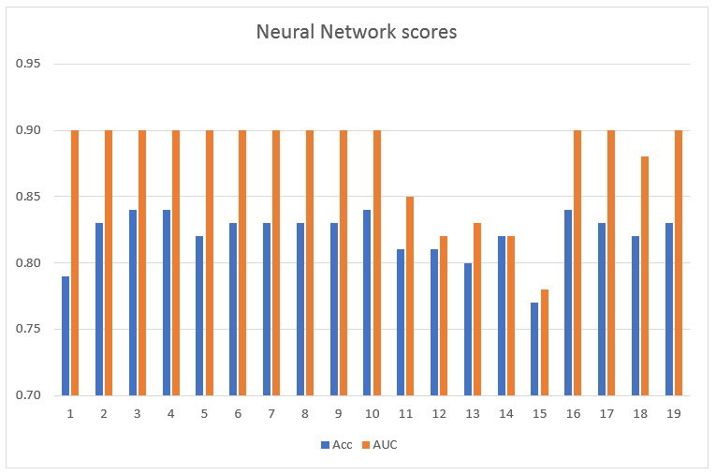
Heart Diseases – Neural Network
Accuracy 0.84
AUC 0.90
Recall 0.80
Notes:
Next I prepared 19 Neural Networks models, the best one was #3 with average accuracy of 0.84, auc 0.90 and recall 0.80.
I attempted to improve it by using grid search, but it was not better

Slide 15
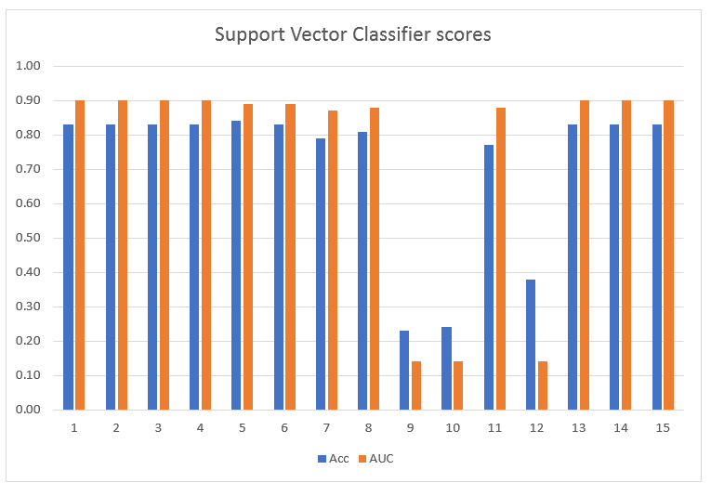
Heart Diseases – Support Vector Classifier (SVC)
Accuracy 0.83
AUC 0.90
Recall 0.79
Notes:
Next I prepared 15 SVC models, the best one was #1 with average accuracy of 0.83, auc 0.90 and recall 0.79.
I attempted to improve it by using grid search, but it was the same.

Slide 16
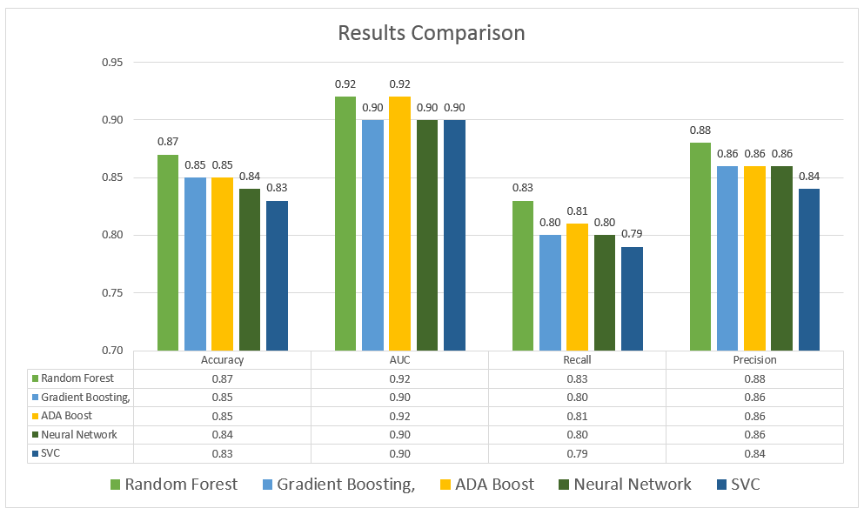
Heart Diseases – Results
Notes:
This chart compares accuracy, auc, recall and precision scores for the best model with in each classifier.
As you can see they are statistically the same, however the best average scores were achieved by Random Forest.

Slide 17
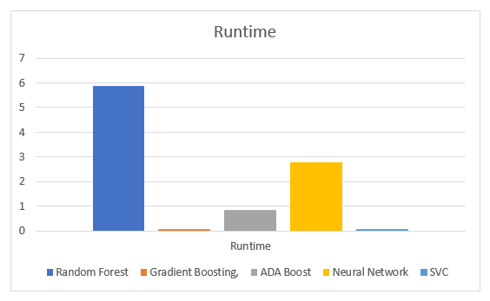
Heart Diseases – Results
Notes:
This chart compares runtimes for the best model within each classifier.
Gradient Boosting and SVC performed the best, Random Forest was the worst, however it had best average scores.

Slide 18
Heart Diseases – Results
Best Model – Random Forest
correctly predicts the existence of heart disease or lack of it in 87 out of 100 cases
probability that the model classifies a patient as having heart disease is 92%
can correctly identify the heart disease in 83 out of 100 cases
predicts the existence of heart disease correctly in 88 out of 100 cases.
Notes:
Regardless the long runtime I chosen Random Forest as the best model
It is easy to explain,
It can correctly predicts the existence of heart disease or lack of it in 87 out of 100 cases
And it can correctly identify the heart disease in 83 out of 100 cases

Slide 19
Heart Diseases – Recommendations
To remember:
high level of triglycerides, which is a measure of a fat in a blood,
smoking,
angina, which is reduced blood flow to a heart muscle due to fat accumulated in arteries
chest pain.
Notes:
My analysis showed that Random Forest and other classifiers could be helpful in diagnosing of heart diseases.
Health practitioners should really pay attention to those feature which turned out to be the most significant.

Slide 20
Heart Diseases – Recommendations
American Heart Association recommends
stop smoking,
choose good nutrition,
lower cholesterol,
lower blood pressure,
be physically active every day”.
Notes:
A lesson learnt is to avoid heart diseases by all cost so please
Stop smoking
Choose good nutrition
Lower cholesterol and blood pressure
Be physically active.
Thank You

